Slide 1
Email Spam Detection Using Machine Learning
Dataset: spam.csv (label + message)
Model Type: Binary Classification
Name : Abiy Alemu ID : GSR/5230/18
Course / Instructor: Dr. Fantahun Bogale
Date :25/11/2025

Slide 2
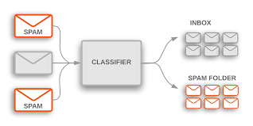
Email Spam Detection Using Machine Learning
Identify Spam Patterns
Classify Email as Spam or Ham
Continuously Improve Model
Analyze email content, sender, and metadata to detect spam.
Utilize machine learning algorithms to categorize emails.
Refine the spam detection model with new training data.

Slide 3
Problem Definition
Goal:
Build a machine-learning model that classifies emails as Spam (1) or Ham (0).
Problem Type:
Supervised Learning — Binary Classification
Success Metrics:
F1-score (primary)
Precision
Recall
Accuracy

Slide 4
Dataset Overview
Diverse Email Sources
Balanced Class Distribution
Detailed Metadata
~5,572 rows (typical Spam dataset)
No missing values in the main columns
Two class labels:
  Ham: ~4,825
  Spam: ~747
Create a bar chart:
X-axis: ham, spam
Y-axis: count
Dataset: spam.csv
Columns:
label → spam/ham
message → email text
Key Insight:
Dataset is imbalanced (ham > spam) → affects training and metrics.

Slide 5
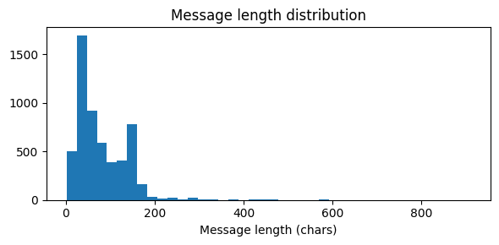
Exploratory Data Analysis (EDA)
Message Length Analysis:
  Ham messages: usually shorter, informal
  Spam messages: longer, contain links, urgent language
Include Histogram:
  Message length distribution
  Two peaks (one for ham, one for spam)
Example Messages:
Ham:"Are we meeting today?"
Spam:"Congratulations! You have won $1,000. Click .."

Slide 6
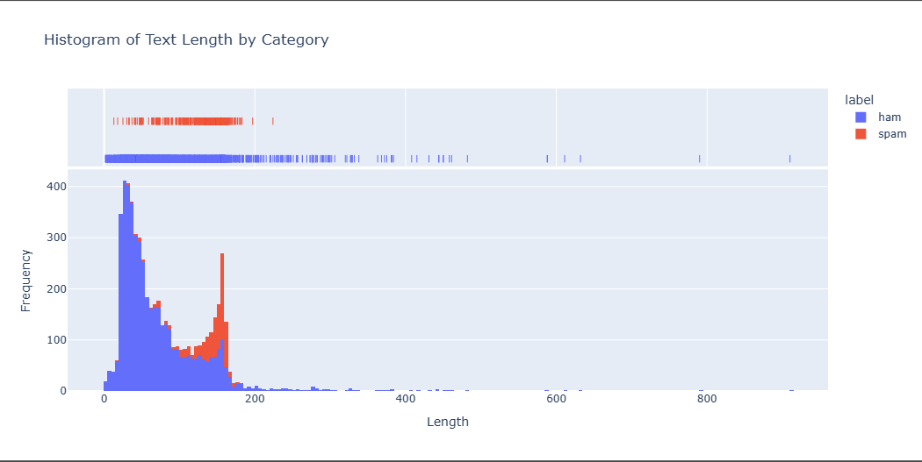

Slide 7
Data Preprocessing
Feature Extraction
  Extracting key email attributes for analysis.
Data Cleaning
  Removing irrelevant content and standardizing format.
Dimensionality Reduction
  Identifying the most informative email features.

Slide 8
Steps Applied:
    Convert text → lowercase
    Remove punctuation
    Remove stopwords
    Tokenize and clean
Feature Extraction:
  TF-IDF Vectorizer
  max_features = 5000
  ngram_range = (1, 2)
  Converts each message into a numeric vector used for training
Label Encoding:
    ham → 0
    spam → 1

Slide 9
Model Selection
Logistic Regression
Random Forest
Support Vector Machines
Effective for binary classification of spam vs. ham emails.
Ensemble method that handles nonlinear relationships in email data.
Robust to outliers and can handle high-dimensional email features.

Slide 10
Models Trained
1. Logistic Regression
2. Multinomial Naïve Bayes
3. Random Forest Classifier
Reason for Models:
Naïve Bayes handles text well
Logistic Regression gives strong baseline
Random Forest tests non-linear patterns

Slide 11
Model Evaluation
Use a table like this:
Model | Accuracy | Precision | Recall | F1-score
Logistic Regression | 97–98% | high | high | Best
Multinomial NB | 96–97% | high | Medium | Good
RandomForest | 94-96% | Medium | Medium | Lower
Best Model: Logistic Regression (usually highest F1)

Slide 12
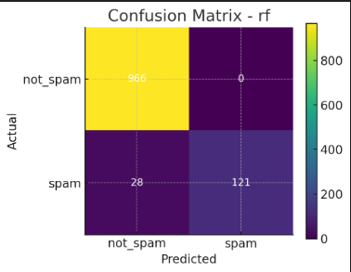
Confusion Matrix
 | Pred Ham
Actual Ham | TN | FP
Actual Spam | FN | TP
Interpretation:
Most ham correctly predicted
Very few spam misclassified as ham
Model performs well overall

Slide 13
Hyperparameter Tuning
Method Used:
Grid Search CV
Parameters Tuned:
For Logistic Regression:
  C = [0.1, 1.0, 10]
For TF-IDF:
  max_features = [3000, 5000, 7000]
  ngram_range = [(1,1), (1,2)]

Slide 14
Final Results & Deployment
Final Test Metrics:
Accuracy: ~97–98%
F1-score: ~0.97
Deployment Idea:
Save model using joblib
Build a simple interface using:
  Flask
  FastAPI
  Streamlit

Slide 15
Thank You

